Slide 1
Android Studio
Università di Modena e Reggio Emilia

Slide 2
Intro
Android Studio is the official Android IDE.
Is based on IntelliJ IDEA.
Includes:
Android SDK and JDK (Java Development Kit)
Gradle plugins
Android emulator
Android profiler
VCS integration
Layout design tool
Debug tools
Testing tools and framework (JUnit)
Access to device’s filesystem
Android logging and output console
Android Project Wizard: simplifies creating new project

Slide 3
Tools

Slide 4
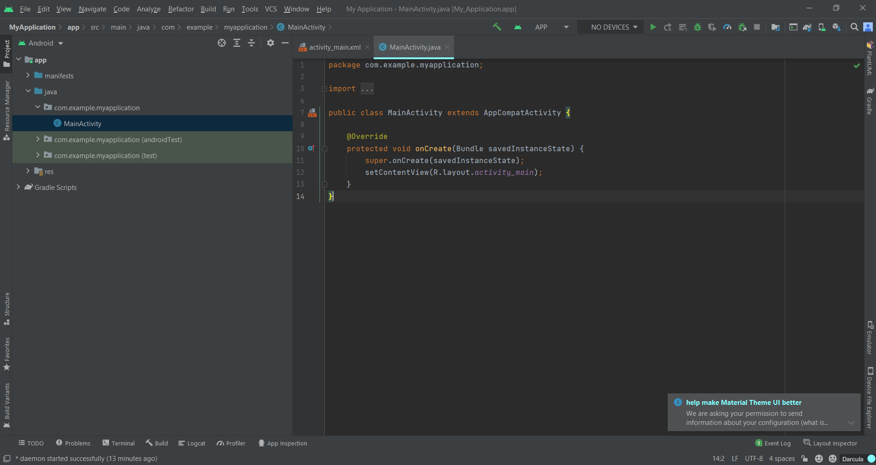
Android Studio Tools
1
2
Menu Bar (yellow)
Toolbar (red)
Navigation Bar (blue)
Editor Window
Status Bar (green)
Tool Window Bar (on the edges of IDE bordered in red)
3
4
6
5

Slide 5
Toolbar
In order, from left to right:
Build project
Run/Debug configurations:
Target devices: list of available device where you can run app
Run/Install app on selected device
Aply changes: apply code changes on app’s version installed on target device
App debug
Profiler: show the behavior and performance of your app in real time (CPU, memory managment, network traffic)
Stop app: force stop of app
Project structure: show project settings
Sync project: sync gradle’s files (external dependencies …)
AVD Manager: manage your virtual device
SDK Manager: manage Additional SDK Components and SDK upgrade.
Now we will discuss them in more detail.

Slide 6
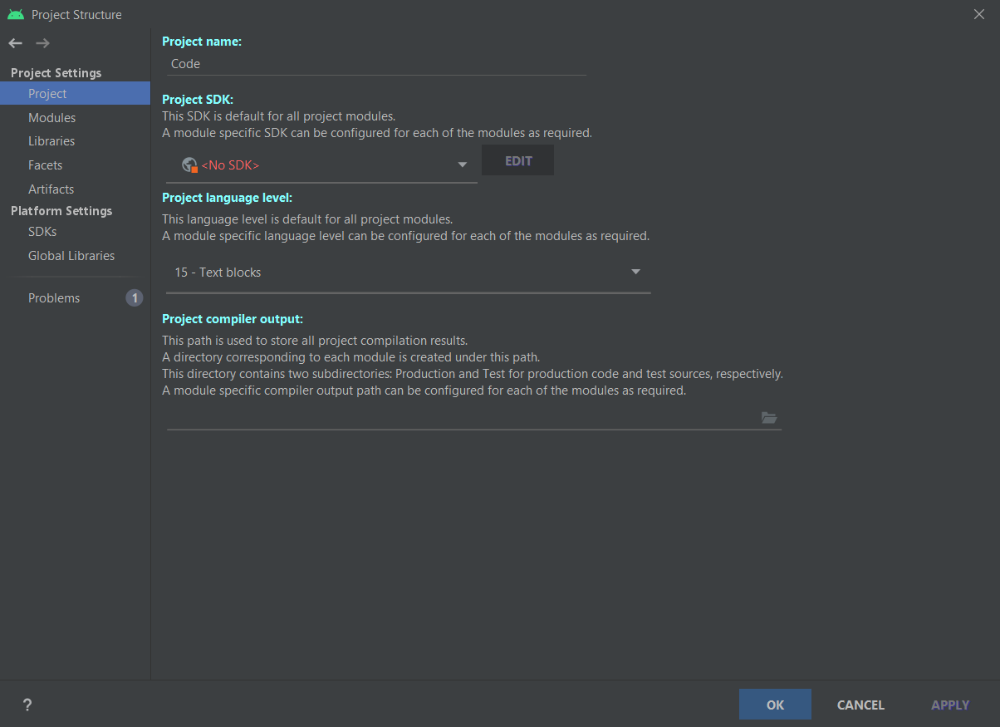
Project structure
File -> project structure
You can find project settings:
Name
Modules: your application modules
Libraries: where you can manage jar dependencies
Platform settings:
SDKs: manage installed JDK and SDK

Slide 7
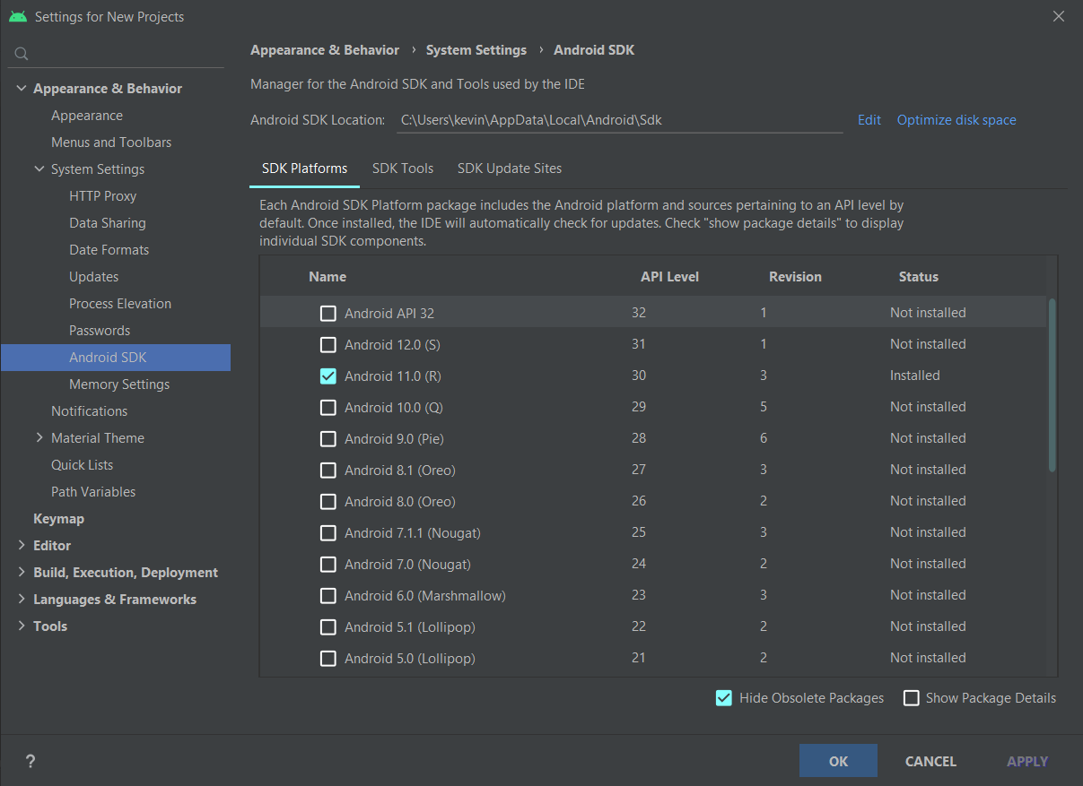
SDK Manager
Tools ➔ SDK manager
Manage Additional SDK Components.
SDK Platform: you can install SDK version and related API
SDK tools: you can see available update and new tools

Slide 8
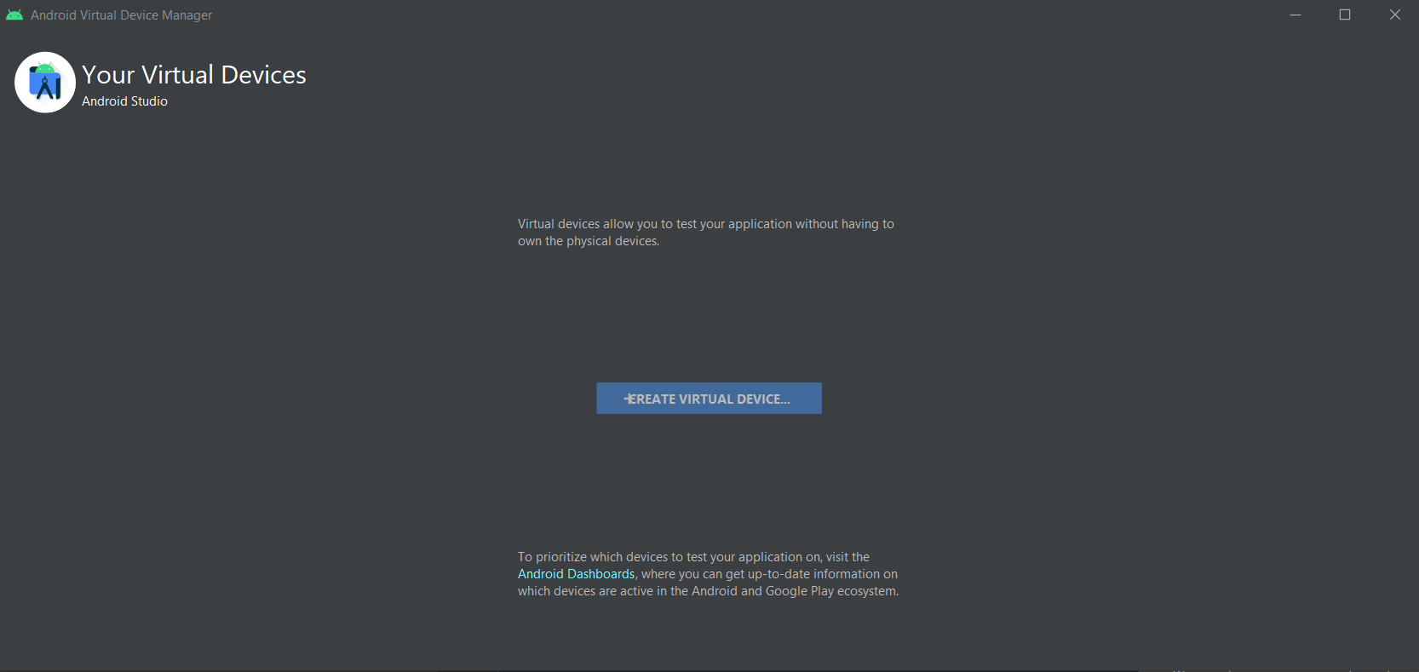
AVD Manager
In Android Studio you can create a AVD (Android Virtual Device) where you can install and run your application.
AVD is a virtual smartphone where you can deploy, run and debug your app
AVD Manager is the tool that help you to create and manage your AVD.

Slide 9
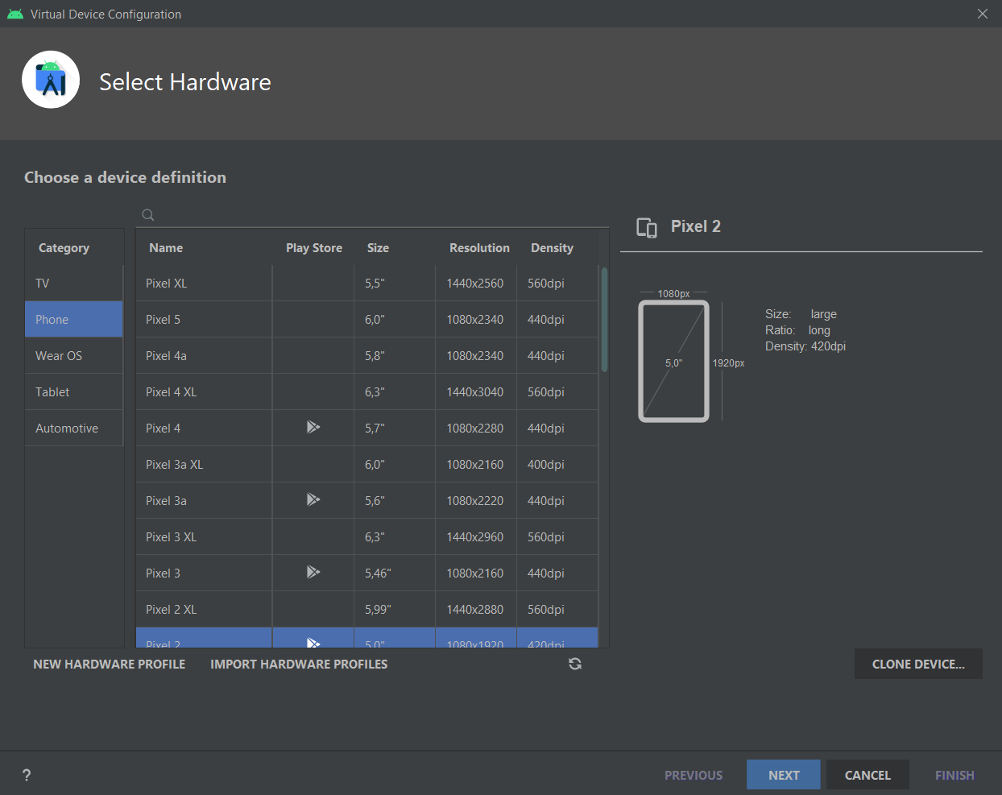
AVD Initialization
You can choose
Type of AVD (Wear, Smarthphone, Tablet, Tv and Automotive)
Specific AVD (e.g. from Google devices list) (is better choose Play Store integrated AVD)

Slide 10
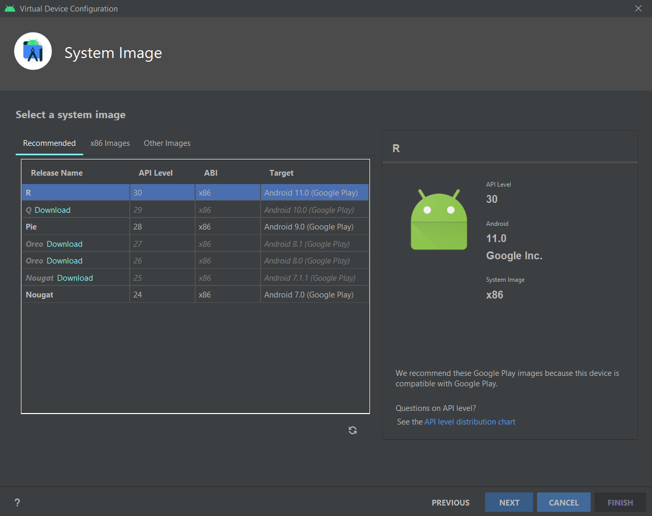
AVD Initialization
API Level (with related Android OS version)

Slide 11
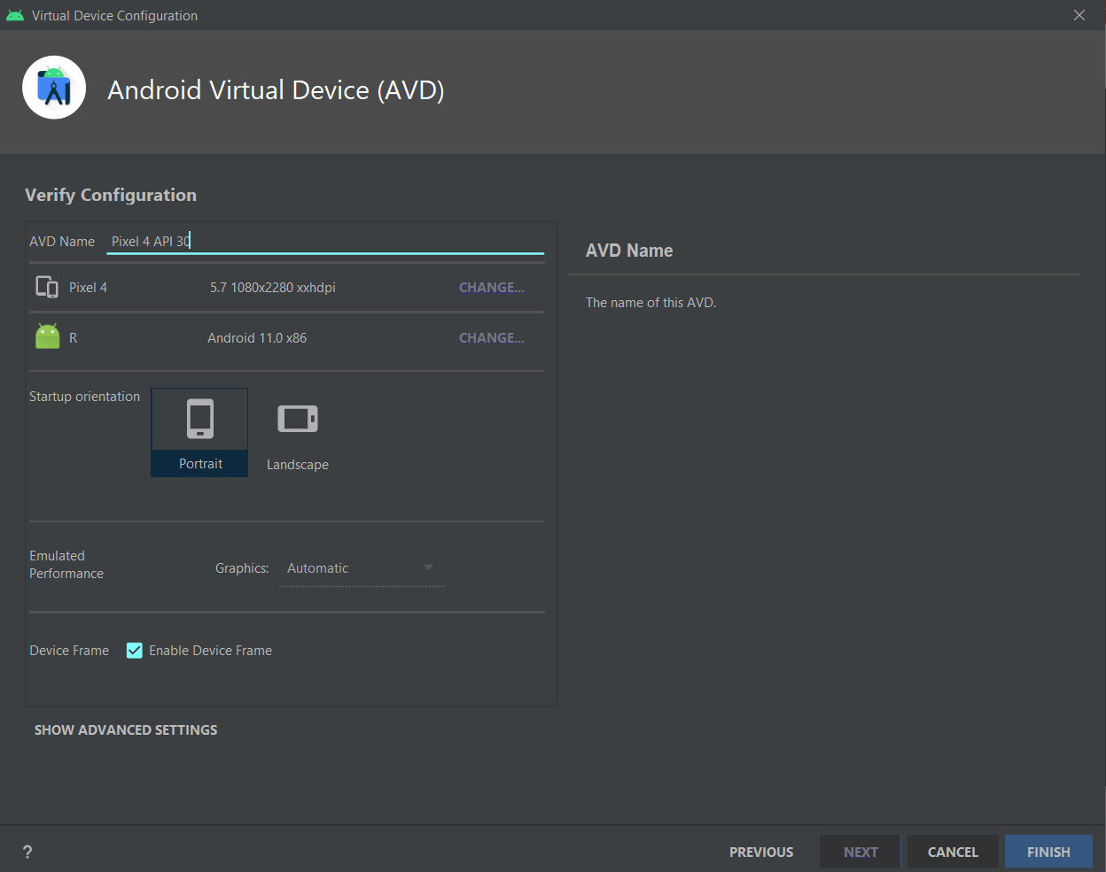
AVD Initialization
Name of AVD
Other technical specifications (display resolution…)

Slide 12
Run and Debug
Run an application means:
Compiles source code to bytecode
Coverts bytecode to Android executable (.dex)
Packages the executable and project’s resources and manifest in Android package (.apk)
Deploys your APK in target device and installs it
Starts application

Slide 13
Run/Debug in real device
Android Studio offers the possibility to install your application and run it in a real Android device
Activate ADB (Android Debug Bridge) on target device (only on Android 6.0 or higher)
Settings ➔ About Phone/Tablet ➔ Software Information
Tap on Build number field seven times (a message appears indicating that developer mode has been enabled)
Go to Settings page and now appears Developer options
Switch on USB debugging option
Connect to PC with USB, device will appear in Android Studio devices list
https://developer.android.com/studio/debug/dev-options

Slide 14
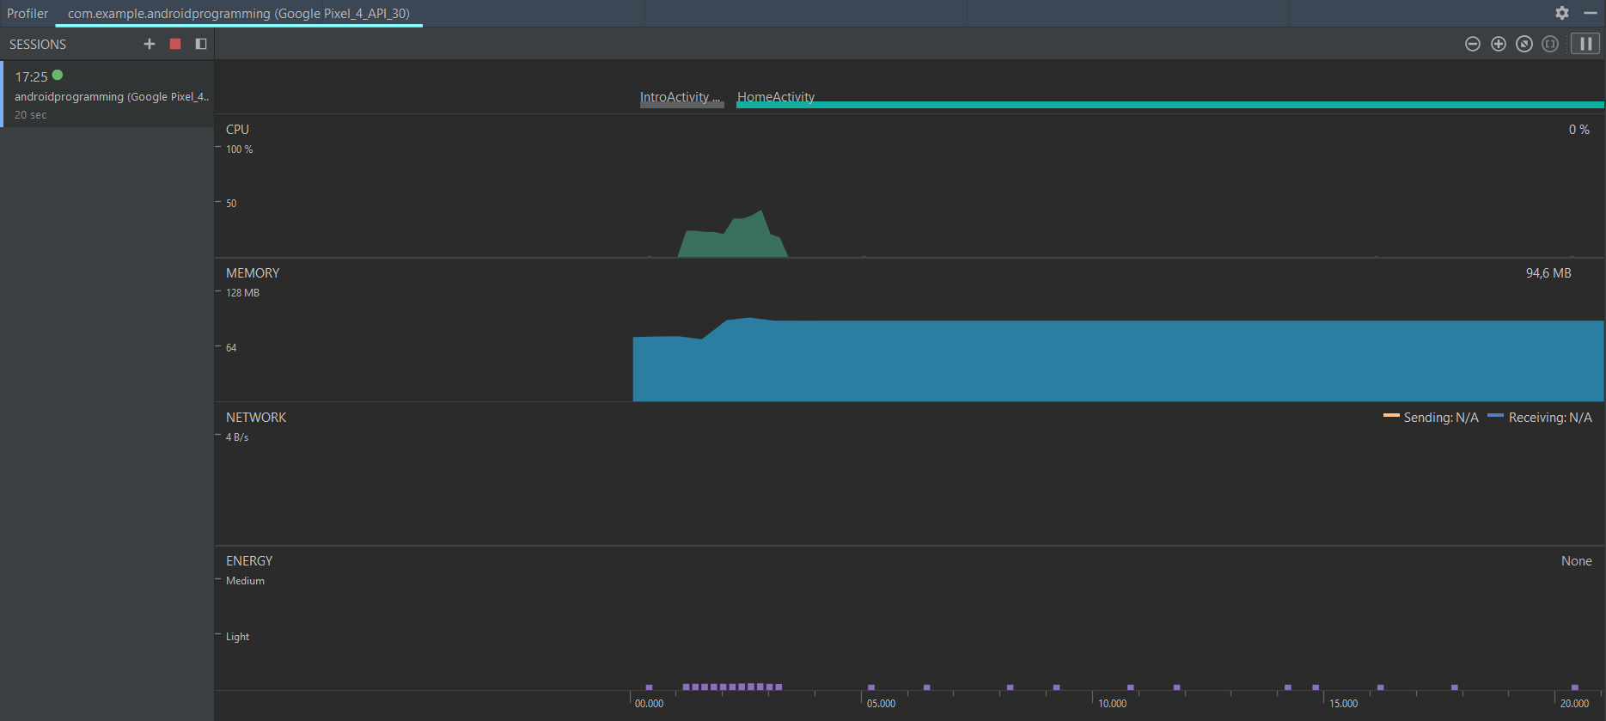
Profiler
You can control system status and hardware work during your application execution:
CPU
Memory
Network
Energy
https://developer.android.com/studio/profile/android-profiler

Slide 15
Tool Window Bar
Tool window bar contains the buttons that allow you to expand or collapse individual tool windows.
On right edge:
Project: show project’s directories
Git tools
Resource manager: show available resources with preview
Structure: open project structure’s window
Build variants
On left edge:
Device file explorer: show device storage
Gradle: show project’s dependencies
On lower edge:
TODO: find TODO elements in your code
Problems: show problem, warning and errors
Terminal: open a terminal of your pc
Build: open build’s window (where you can see build’s log)
Logcat: displays system messages, such as when a garbage collection occurs, and messages that you added to your app with the Log class
Profiler
Run
App inspector: inspect database and background task of running process

Slide 16
Device file explorer
You can also explore storage device
If you use AVD, storage is a directory in your PC
If you use Real device is the real file system
To see your app directory in storage
File explorer -> Data -> Data -> your_app_package_name (e.g. com.example.MyApplication)

Slide 17
Gradle
Gradle is an open-source and general-purpose build automation tool that is designed to be flexible enough to build almost any type of software.
Is based on Groovy or Kotlin scripts
Run on JVM (to use it you must install JDK)
Gradle manage your android project build, dependencies, versions, resources…
https://developer.android.com/studio/build

Slide 18
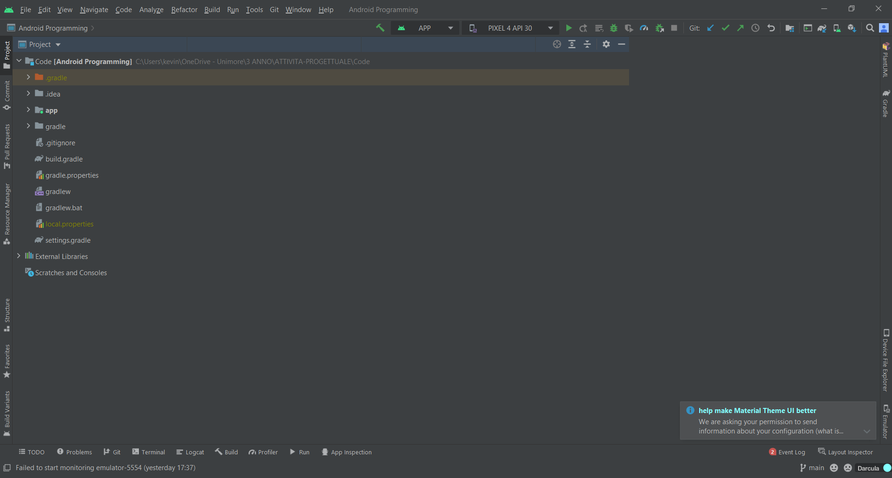
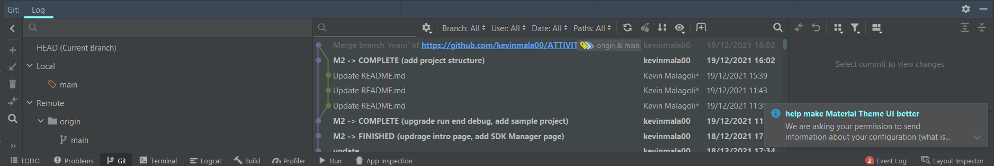
Git tools
You can find git tools in:
Toolbar: allow you to make pull, commit and push quickly
Menubar: you can find a list of all git commands
Tool Window Bar: you can find diagram of all actions in git repository

Slide 19
Visual layout editor
Android Studio offers 3 mode to manipulate graphic element (Layout, Drawable, ecc.), you can choose when you open an xml file
Code mode: use only xml
Split mode: use xml and graphic tool
Design mode: use only drag and drop graphic tool
https://developer.android.com/studio/write/layout-editor

Slide 20
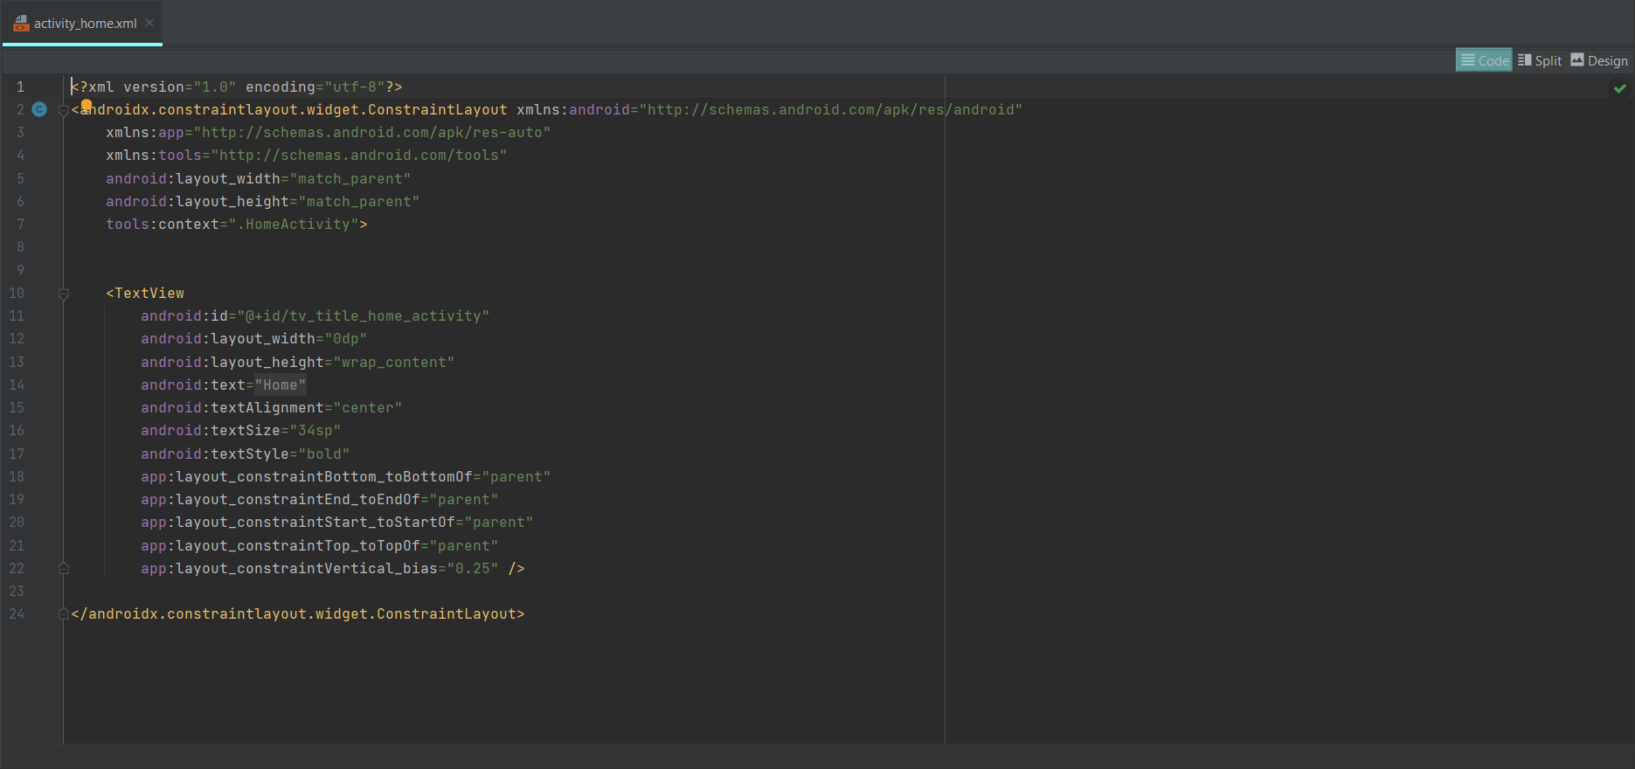
Code Mode

Slide 21
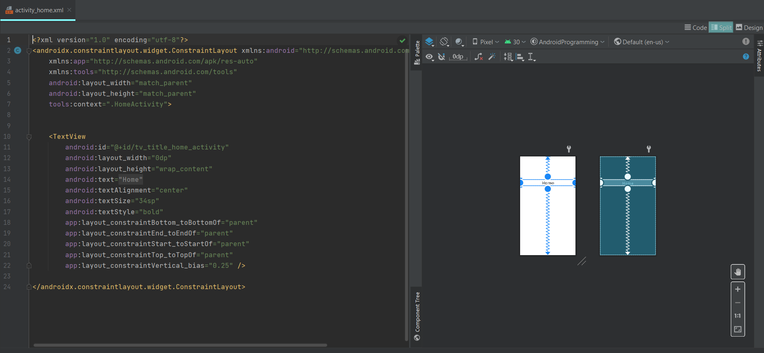
Split Mode

Slide 22
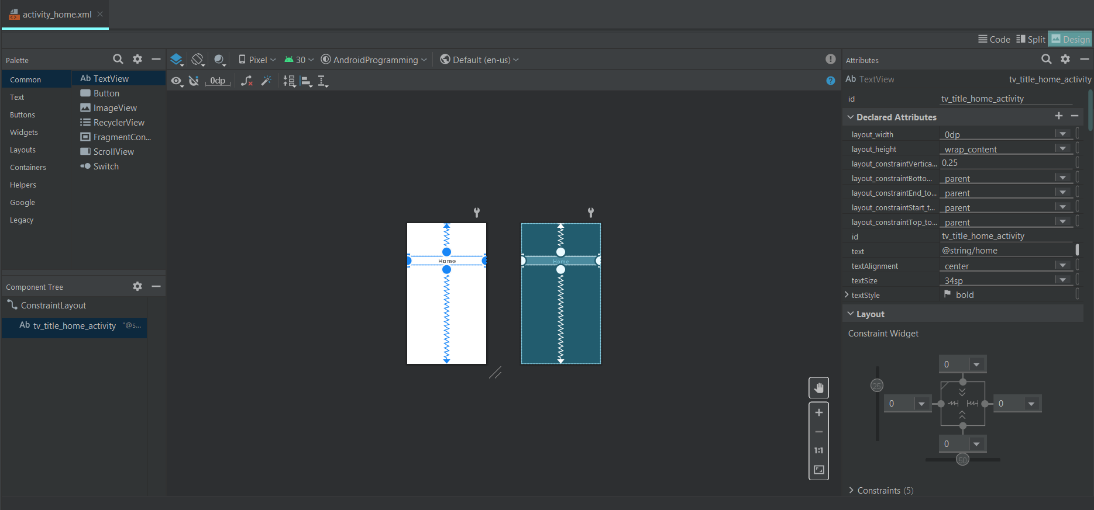
Design Mode

Slide 23
Other tools
SQLite3: From a remote shell to your device or from your host machine, you can use the sqlite3 command-line program to manage SQLite databases created by Android applications. https://developer.android.com/studio/command-line/sqlite3

Slide 24
Project creation

Slide 25
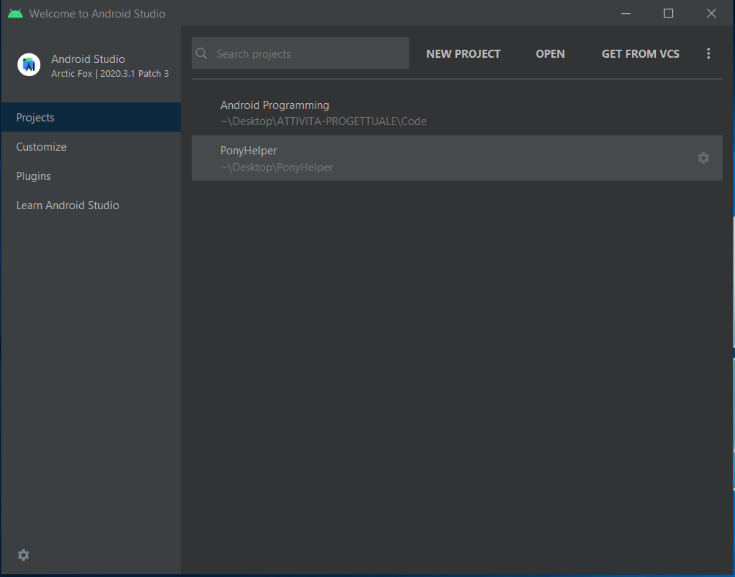
Project creation
Android Studio offers you different way to start projects:
New project: you can start an empty project
Open project: you can open existing project
Import from VCS: you can import project from VCS (Version Control System) thank to GitHub plugins
Open sample project

Slide 26
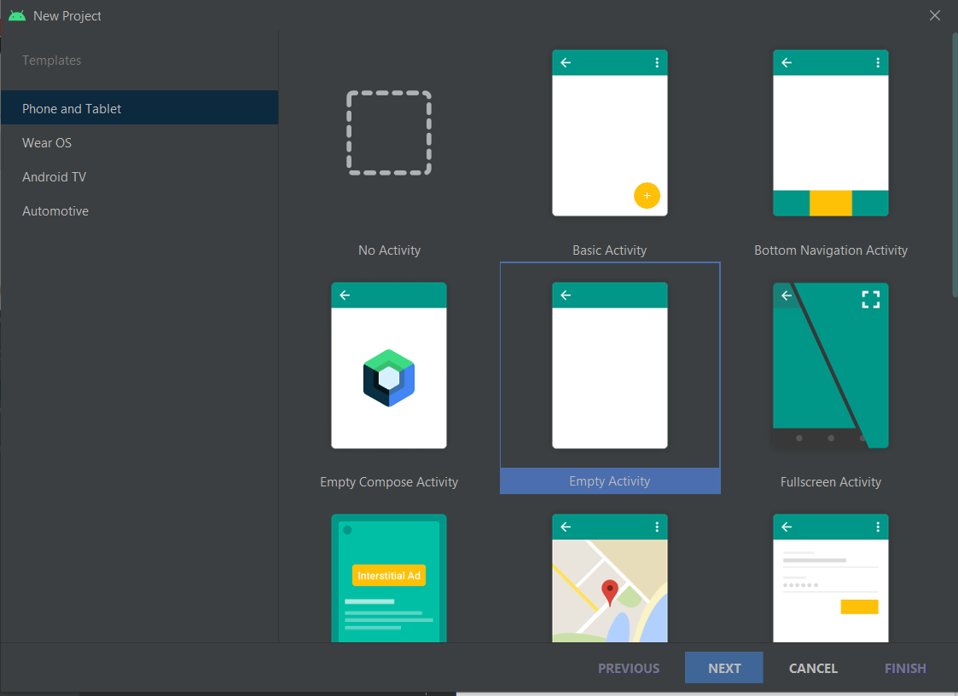
New project
Android Project Wizard helps you to create empty project
You must choose first Activity type, the usual choice is "empty", because you can customize it after
We will see later what is an Activity, for now, it is enough for you to know that it is the class that manages what appears on the screen

Slide 27
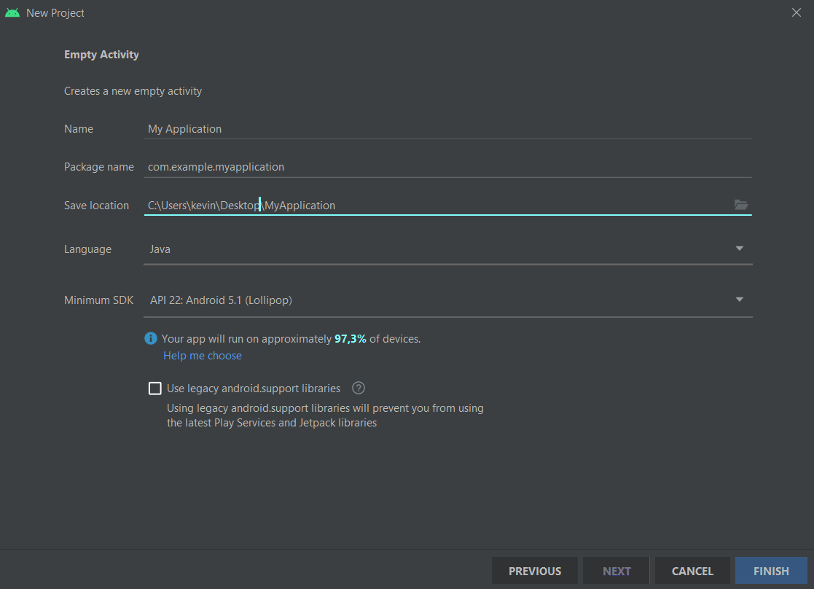
New project (2)
Configure application properties:
Name: name of the application
Package name: name of package where it will be saved other classes and file in the future
Save location: choose a path in your PC to save the project
Language: language of the project
Minimum SDK: version of operating system (API) for develop you application (will affect on download’s capacity on Play store)

Slide 28
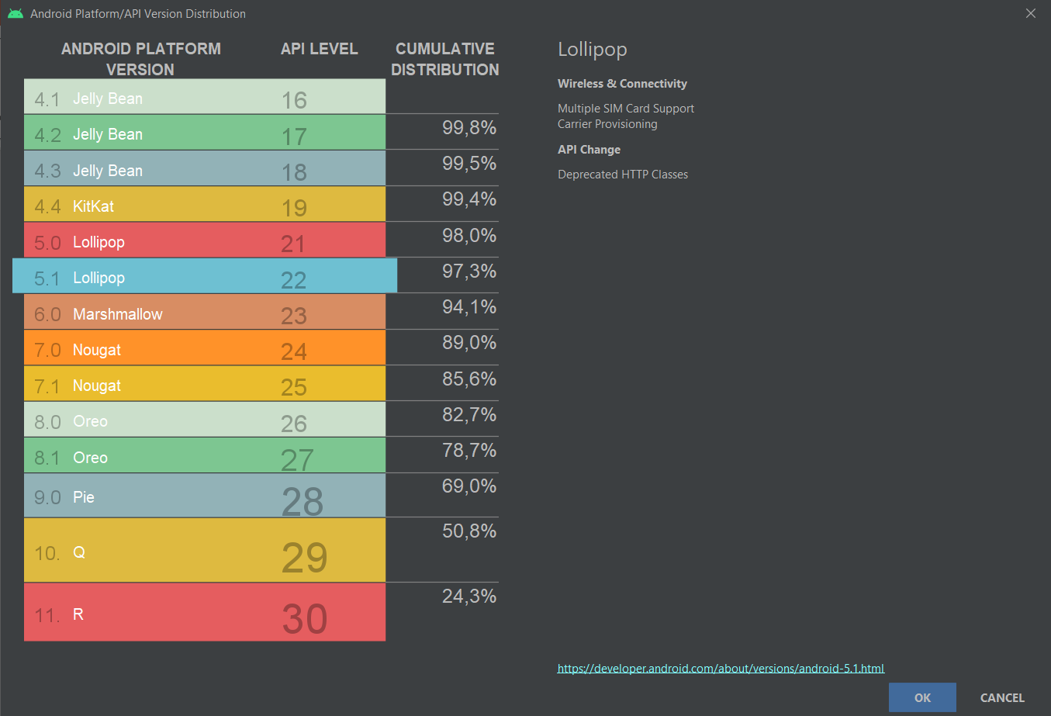
New project (3)
Android studio helps you to choose perfect target Android API for your application, it shows related distibution

Slide 29
New project (4)

Slide 30
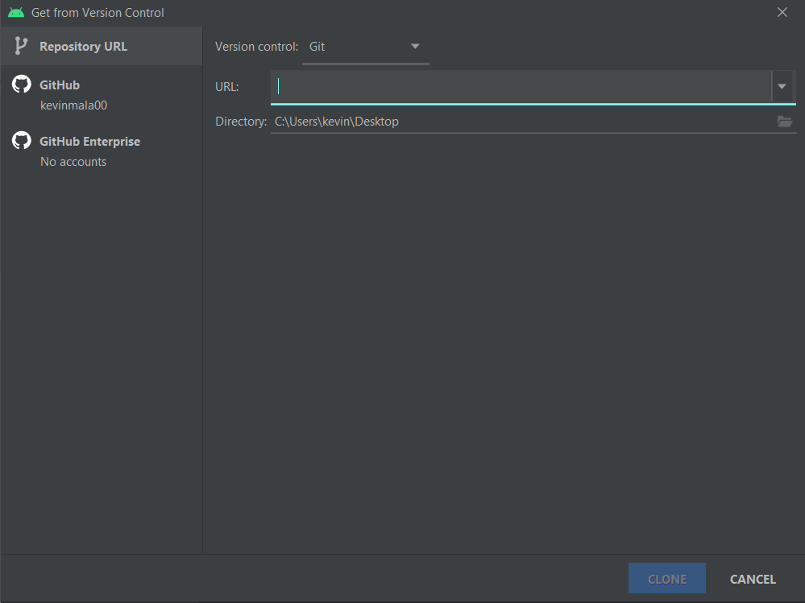
Import from VCS
Android Studio supports a variety of version control systems (VCS’s), including Git, GitHub, CVS, Mercurial, Subversion, and Google Cloud Source Repositories.

Slide 31
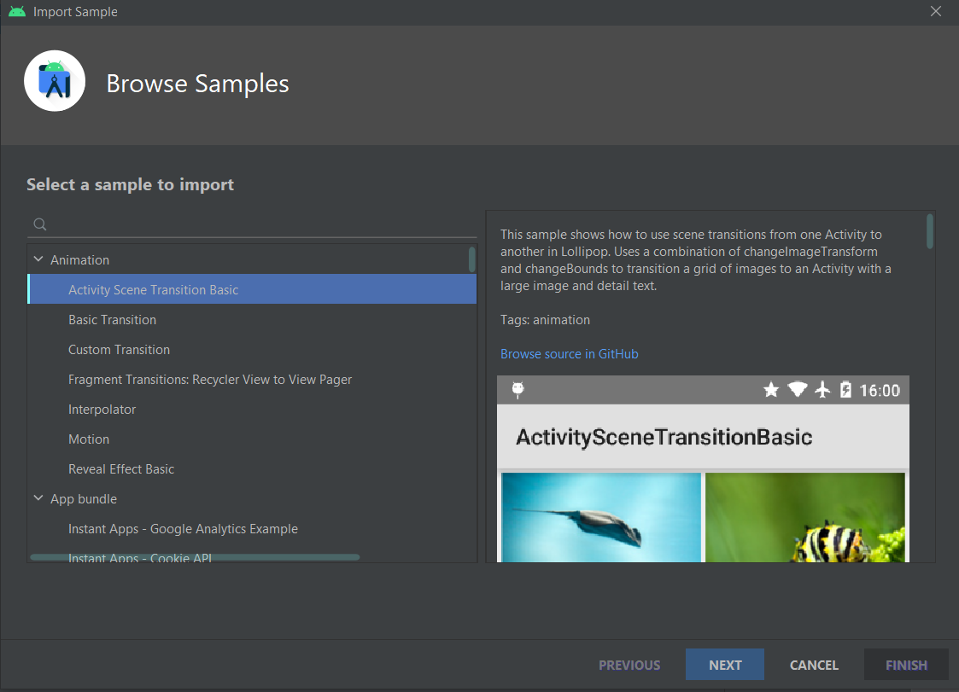
Open sample project
File ➔ new ➔ import sample
Android studio offers the opportunity to import sample project
All sample code in Android Studio are available at https://github.com/googlesamples/

